Slide 1
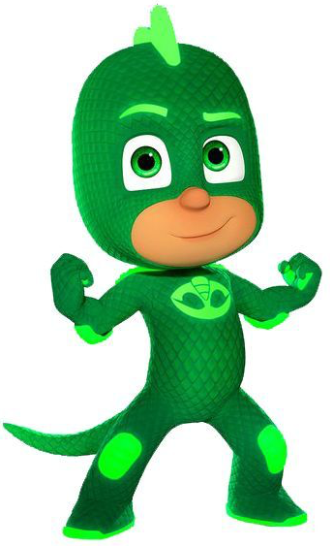
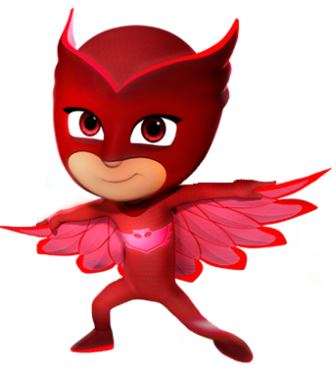
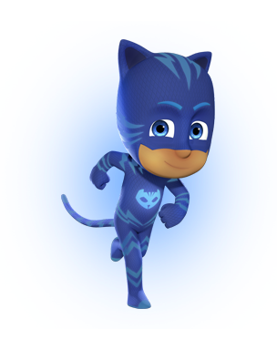
SARA IS 4!!!
SARA IS 4!!!
SARA IS 4!!!
SARA IS 4!!!
Happy Birthday
Happy Birthday
Happy Birthday
Happy Birthday
19 Nov 2009
19 Nov 2009
19 Nov 2009
19 Nov 2009
SARA IS 4!!!
SARA IS 4!!!
SARA IS 4!!!
SARA IS 4!!!
Happy Birthday
Happy Birthday
Happy Birthday
Happy Birthday
19 Nov 2009
19 Nov 2009
19 Nov 2009
19 Nov 2009

